Slide 1




Car Race

Slide 2







void
IEEE
3M
stetch
Black hat

Slide 3

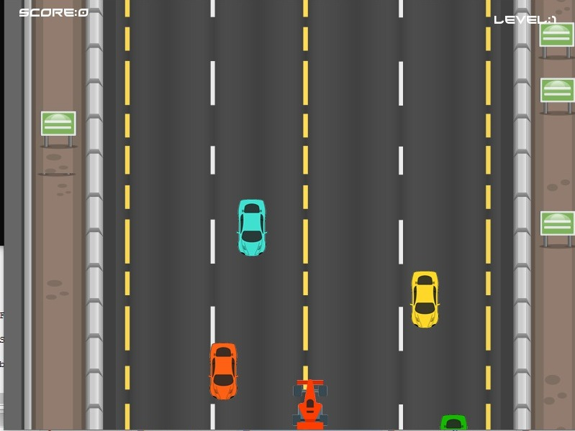
CAR

Slide 4
SCORE

Slide 5
LEVEL

Slide 6


Slide 7
Game Over..!!
Click here

